Slide 1
Lecture:
Dynamics of a quantum gas
5.1 Collective modes of a trapped quantum gas
5.2 Sound
5.3 Measuring Bogoliubov excitations
5.4 Solitons
5.5 Quantized Vortices
- creating and observing vortices
- vortex lattice
- Critical Rotation

Slide 2
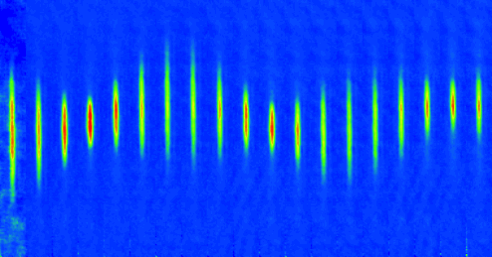
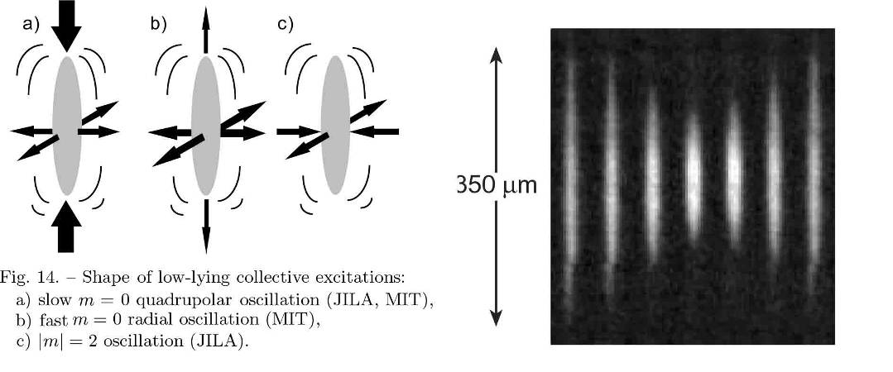
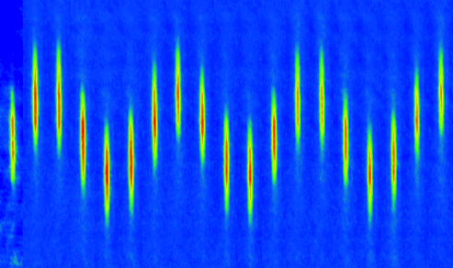
Shaking the BEC
“Non-destructive” observation of a
time-dependent wave function
Quadrupole oscillations
5 milliseconds per frame
Sloshing motion
10 msec. per frame
a very sensitive measurement tool: any change in the potential will change the oscillation frequency
application: Atom-Surface interaction, Van deer Waals and Casimir Polder interaction

Slide 3
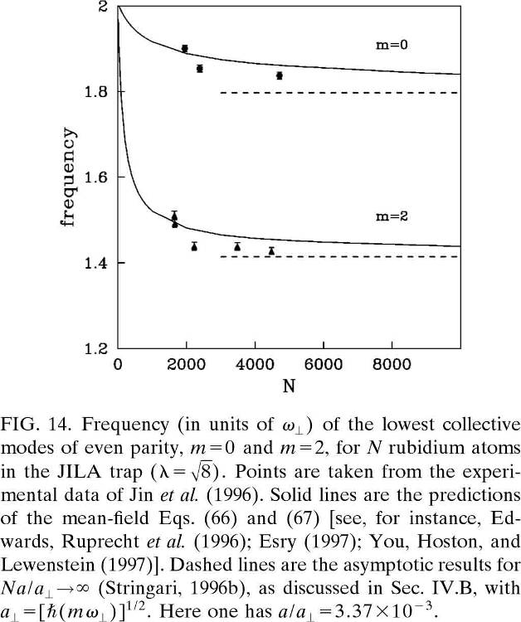
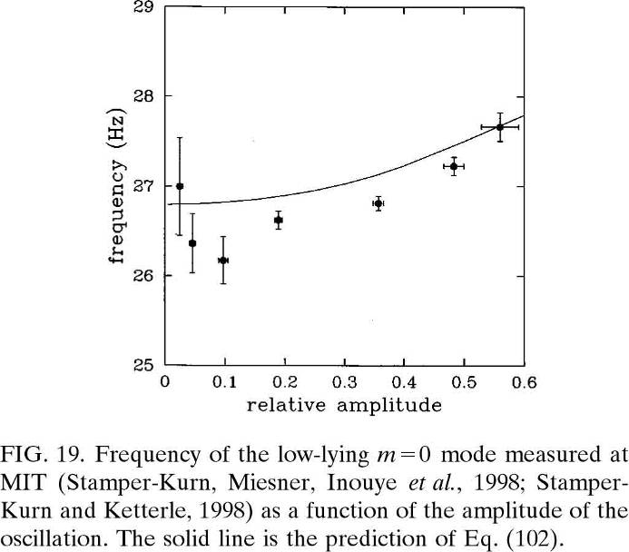
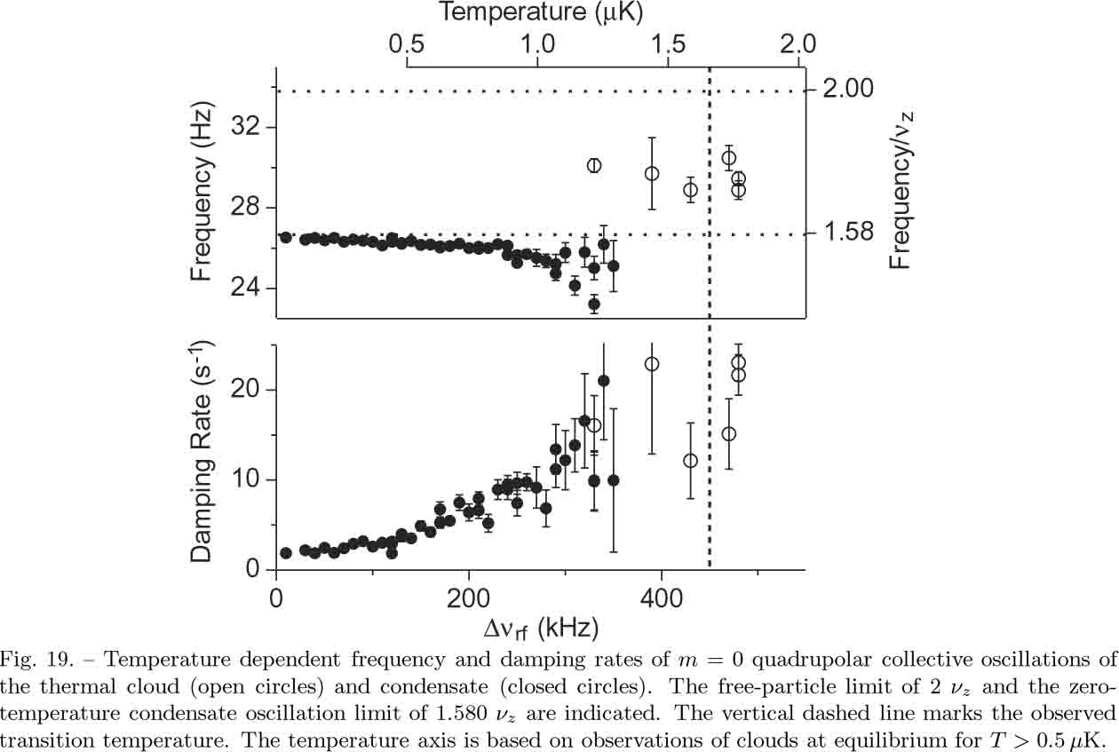
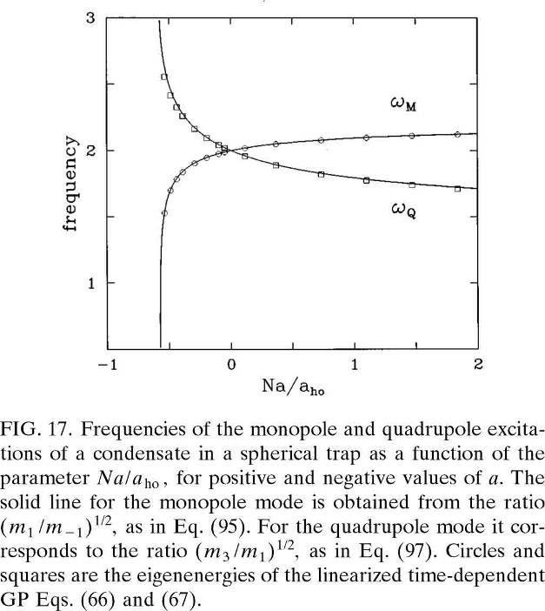
Shaking the BEC
temperature and density dependence

Slide 4
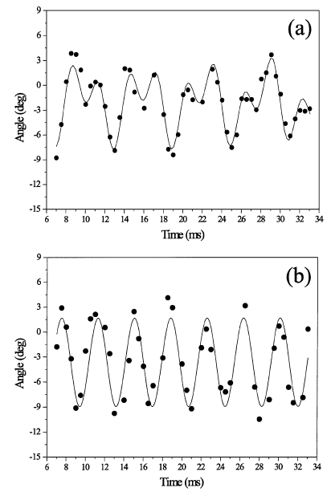

Scissors Mode
O.M. Marago et al. Phys. Rev. Lett. 84, 2056 - 2059 (2000)

Slide 5
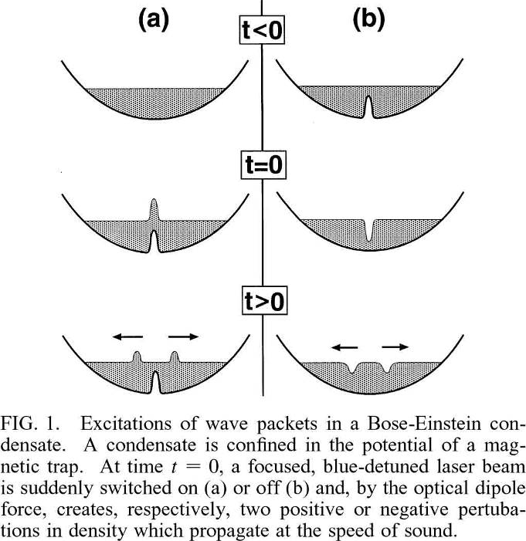
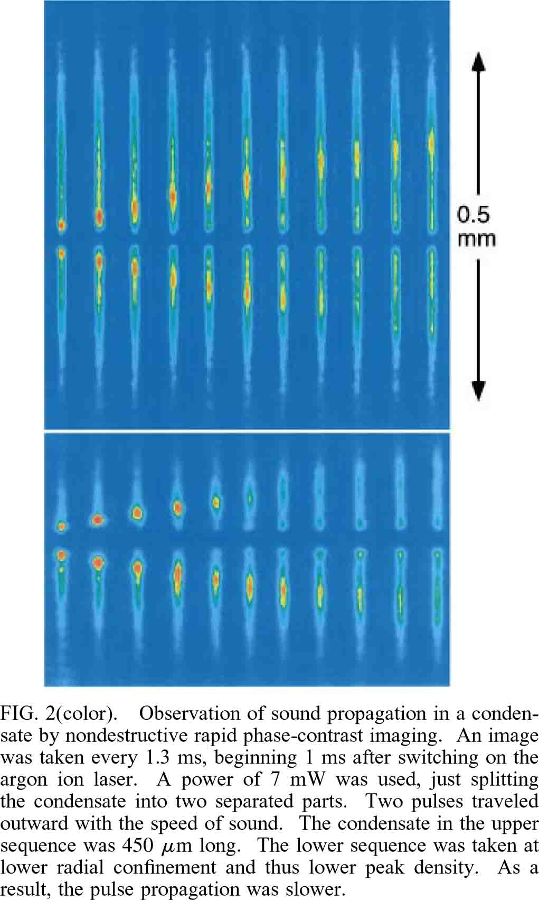
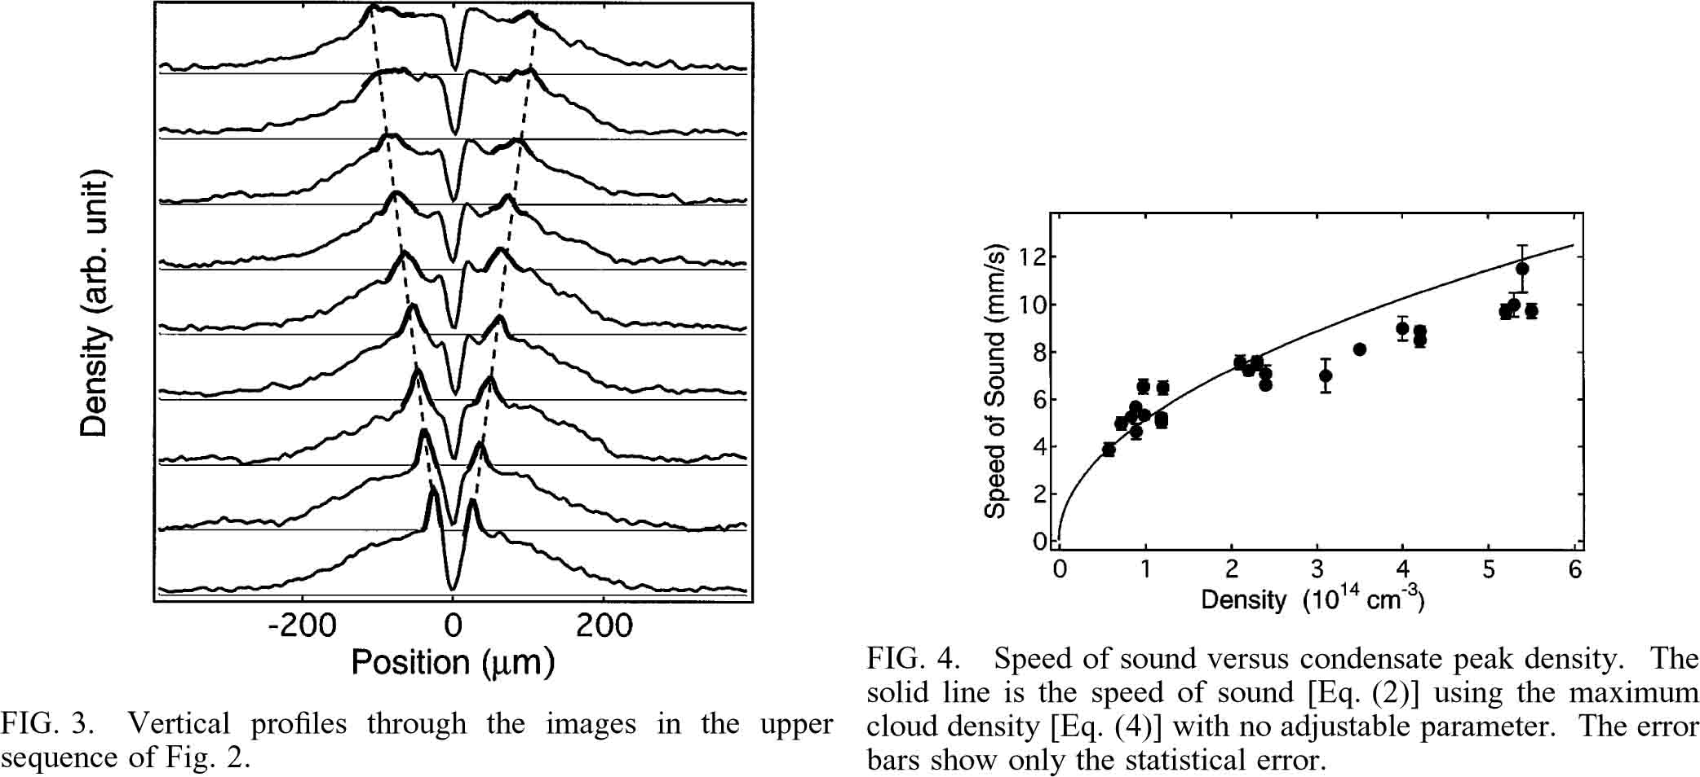
Sound propagation
M.R. Andrews PRL79, 553 (1997)
Sound = propagating density perturbations

Slide 6
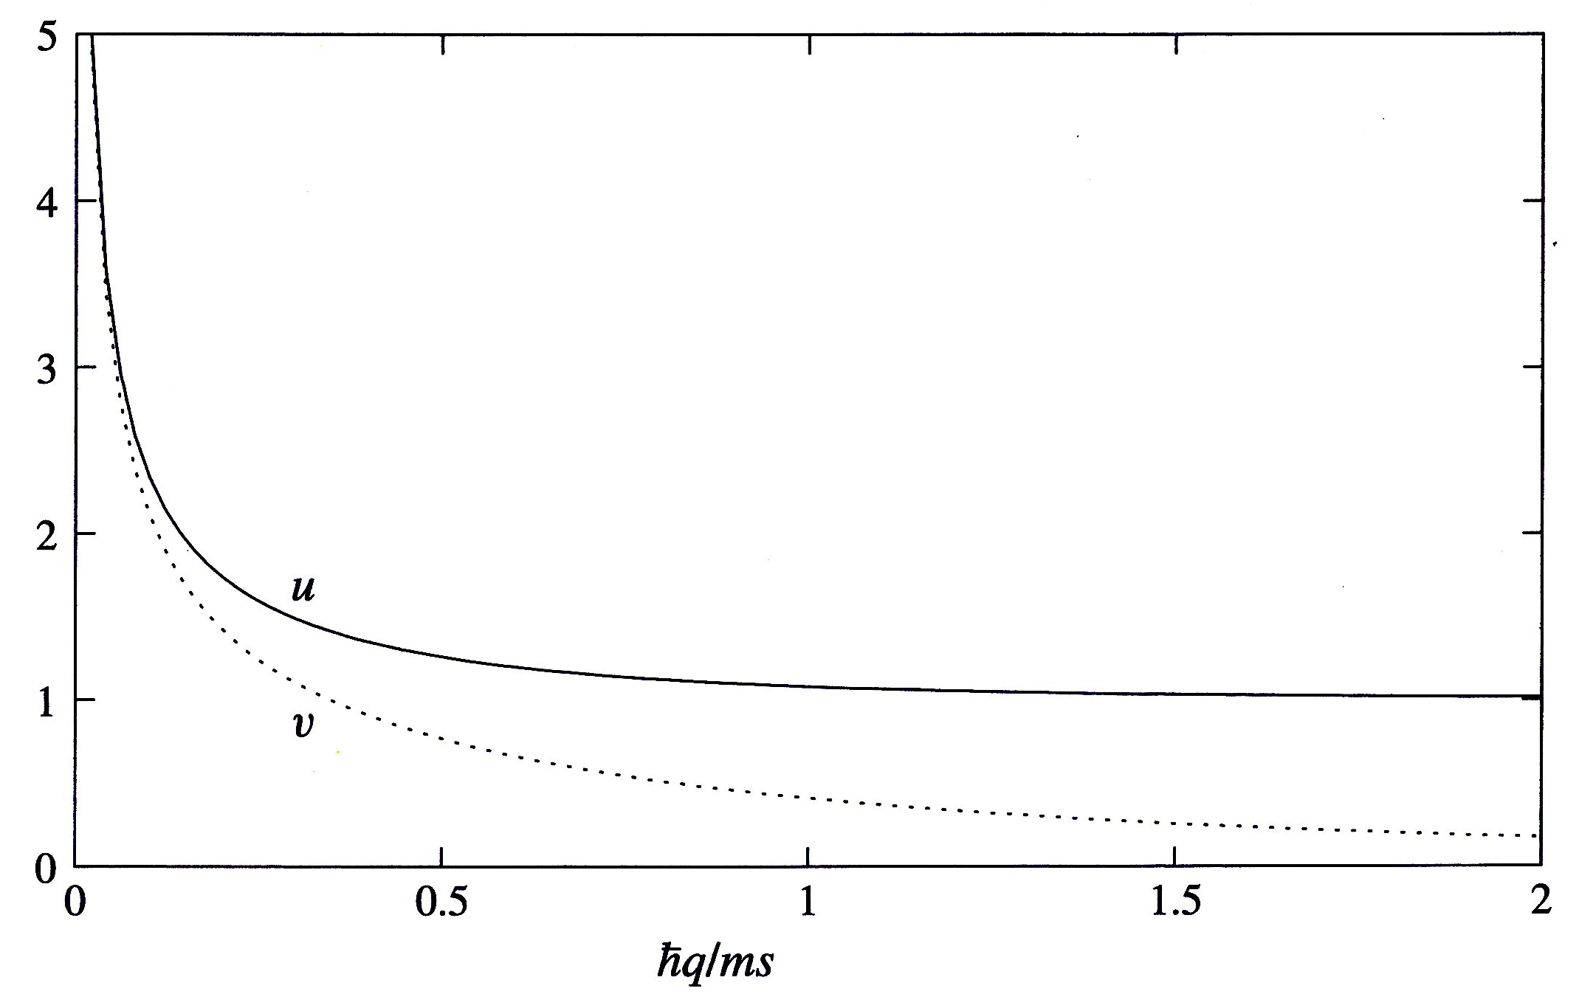
Bogoliubov Excitation Spectrum
high energies:
particle like excitations
coeff of Bogoliubov transf:
cross over
low energies:
excitations: sound waves
sppeed of sound: c
coeff of Bogoliubov transf:

Slide 7
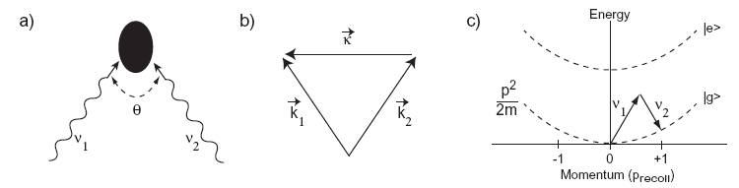
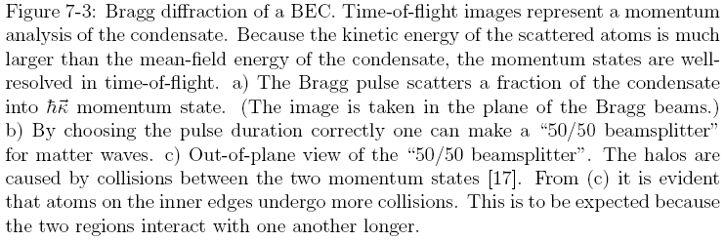
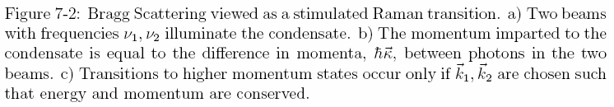
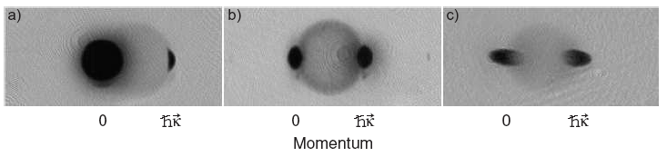



Bragg Spectroscopy

Slide 8
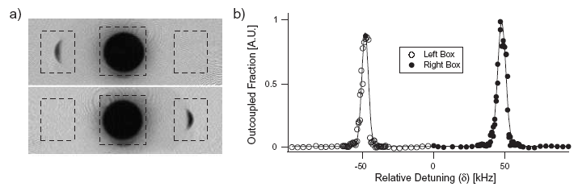
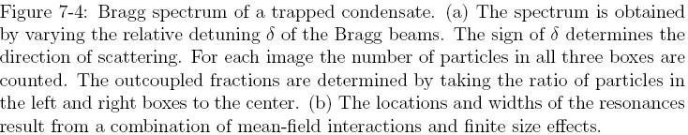
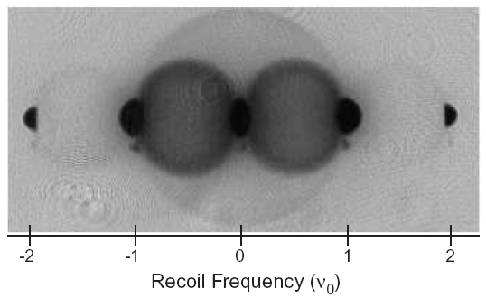

Bragg Spectroscopy

Slide 9
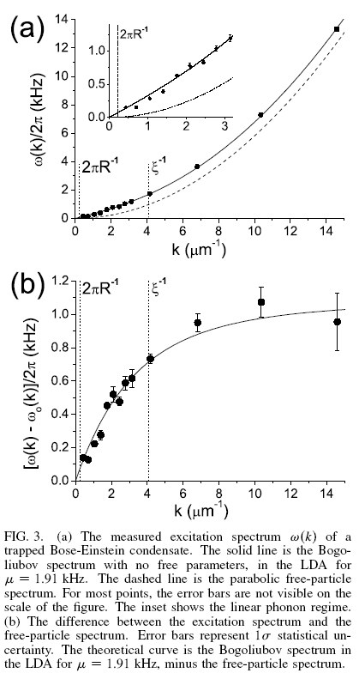
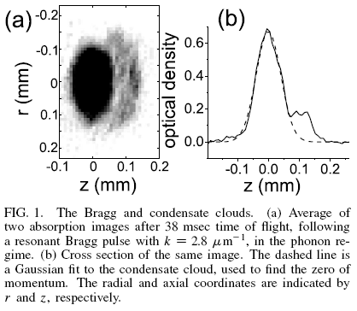

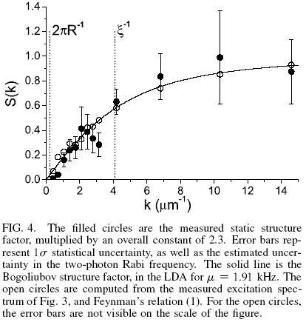
Excitation Spectrum of a Bose-Einstein Condensate
PRL 88, 120407 (2002)
Dynamic structure factor S(k,ω):
response to excitation
Static structure factor S(k):
Fourier transform of the density correlation function

Slide 10
Solitons
Soliton is a self-reinforcing solitary wave (a wave packet or pulse) that maintains its shape while it travels at constant speed
GP equation: Soliton solutions for repulsive interaction: dark soliton
stationary solution
moving solution
velocity u is related to the density ratio n_{min}/n₀
change of phase though the soliton
soliton solutions for attractive interaction: bright soliton
self bound states localized in space

Slide 11
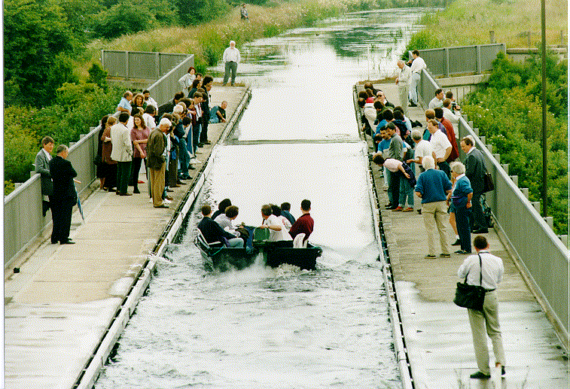
Solitons
John Scott Russell (Scottish engineer 1808-1882)
September 1844:
``I was observing the motion of a boat which was rapidly drawn along a narrow channel by a pair of horses, when the boat suddenly stopped - not so the mass of water in the channel which it had put in motion; it accumulated round the prow of the vessel in a state of violent agitation, then suddenly leaving it behind, rolled forward with great velocity, assuming the form of a large solitary elevation, a rounded, smooth and well-defined heap of water, which continued its course along the channel apparently without change of form or diminution of speed. I followed it on horseback, and overtook it still rolling on at a rate of some eight or nine miles an hour, preserving its original figure some thirty feet long and a foot to a foot and a half in height. Its height gradually diminished, and after a chase of one or two miles I lost it in the windings of the channel. Such, in the month of August 1834, was my first chance interview with that singular and beautiful phenomenon which I have called the Wave of Translation''.
solitons as solutions of nonlinear differential equations which
  represent waves of permanent form;
  are localised, so that they decay or approach a constant at infinity;
  can interact strongly with other solitons, but they emerge from the collision unchanged apart from a phase shift.
Many exactly solvable models have soliton solutions, including the Korteweg-de Vries equation, the nonlinear Schrödinger equation, the coupled nonlinear Schrödinger equation, and the sine-Gordon equation.
The mathematical theory of these equations is a broad and very active field of mathematical research.

Slide 12
Dark Solitons in a BEC

Slide 13
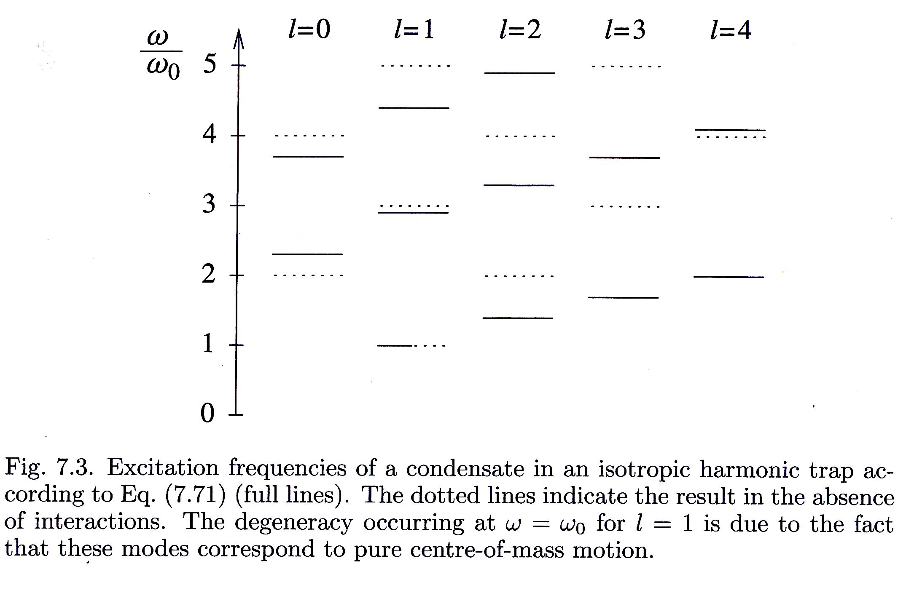
Excitation Spectrum

Slide 14
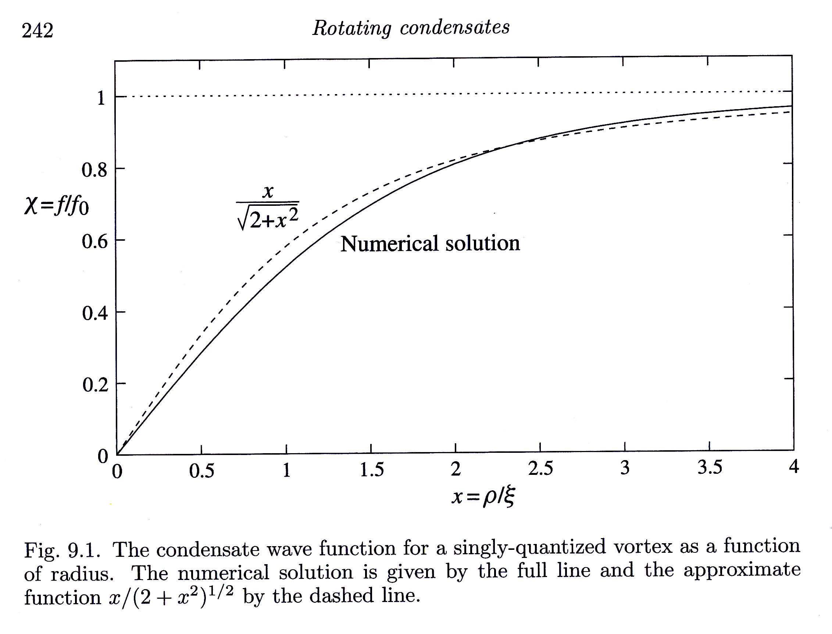
Structure of a Vortex
axial symmetry: cylindrical coordinates
from he velocity field we get an
additional term in the energy
cylindrical GP equation for f
scaled variables
uniform
medium
approximate solution
numerical solution
energy per vortex

Slide 15
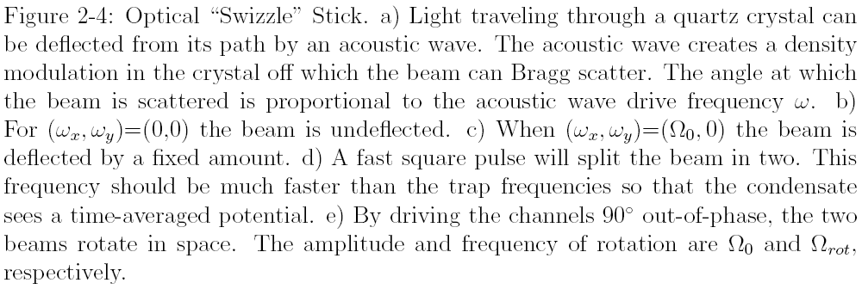
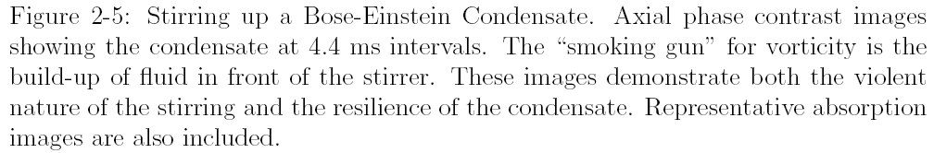
Making Vortices

Slide 16
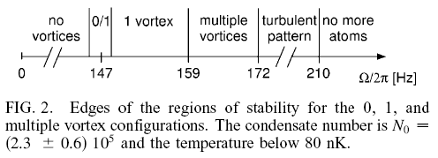
Vortex Formation
vortices are created by surface instabilities:
Landau criterion: above a critical velocity,
the flow at the surface becomes turbulent
and breaks apart into vortices

Slide 17
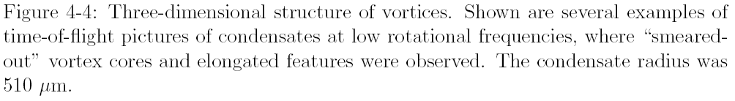
3-dim Structure

Slide 18
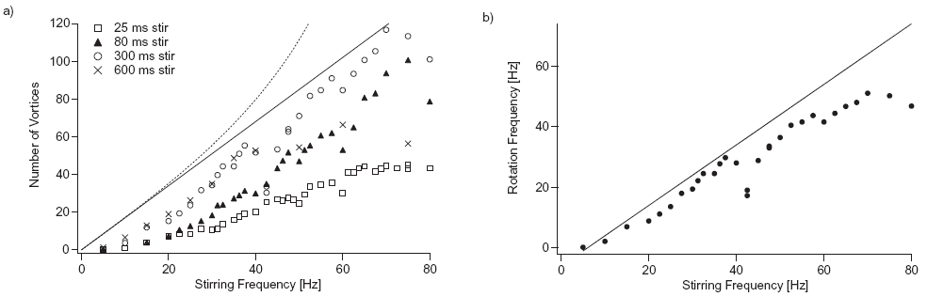
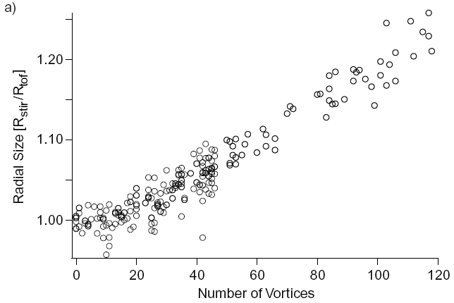
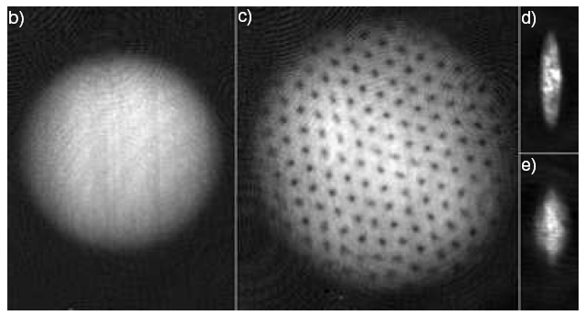
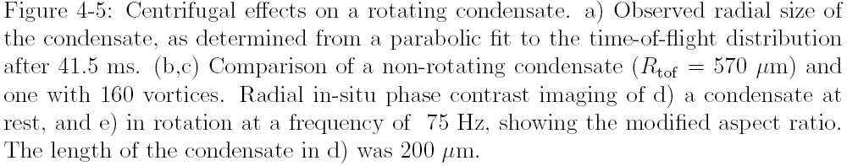
Large number of Vortices

Slide 19
Crystallization of the Vortex lattice

Slide 20
Fast Rotation
Quantum Hall states in rotating BEC
Rotating harmonic trap: transform into the co rotating frame
formally equivalent to a particle with charge q*
moving in an effective magnetic field B*
the Hamiltonian is there for reminiscent to the
Quantum Hall effect: filling factor ν
To achieve these states the rotation frequency ahs to be ~ trap frequency
Then the centrifugal potential exactly compensates the trapping potential
-> looks like a free 2d system with a coupling to vector potential like in electro magnetism

